Slide 1

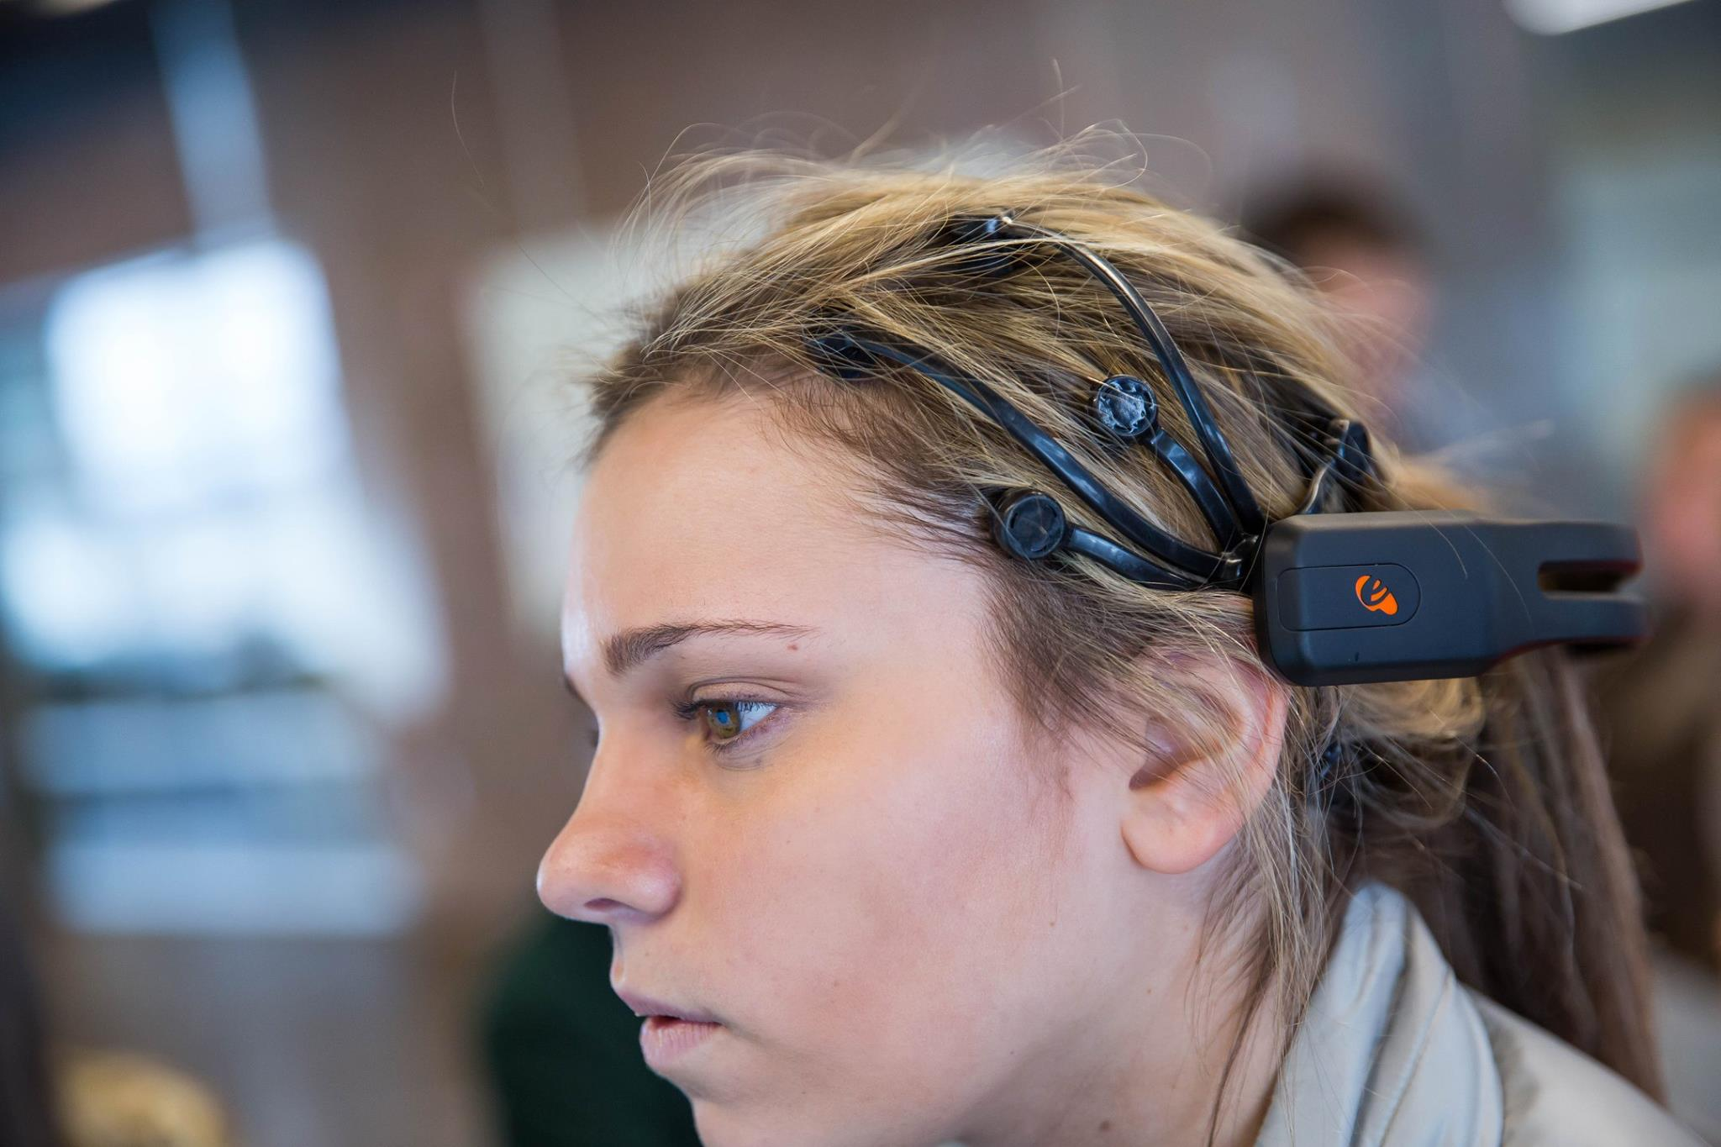
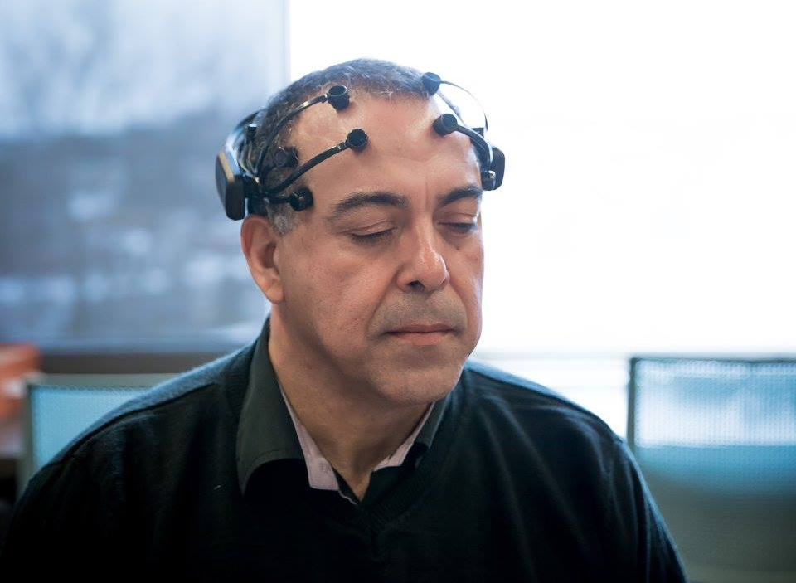
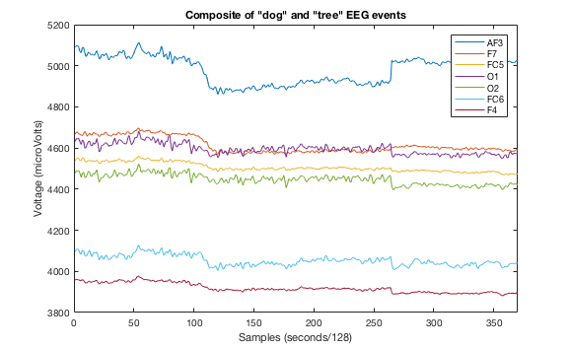
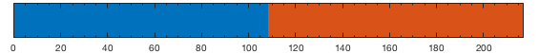
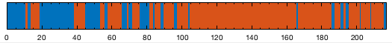
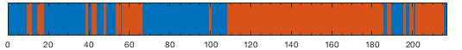
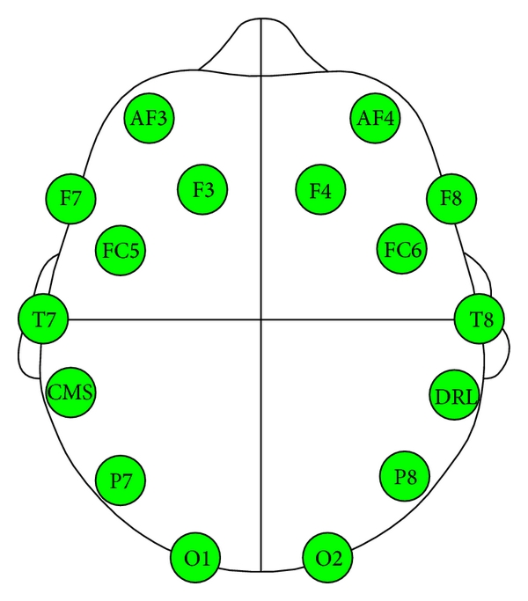
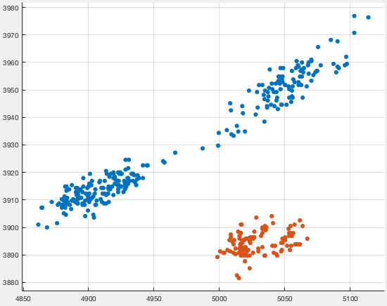


Statistical classification of events in EEG data
Willie Beeson¹, Viraat Das², Frances Van Scoy³
1. Department of Physics & Astronomy, West Virginia University
2. Morgantown High School
3. Lane Department of Computer Science & Electrical Engineering, West Virginia University
Introduction
EEG presents a non-invasive way to monitor brain activity, and is advantageous for its portability and accessibility. We seek to develop a method of classifying stimuli, impulses, and thoughts for the development of a brain computer interface for therapy and treatment of people with speech-impairing conditions such as aphasia. There are many different forms of aphasia, but in many, individuals lose ability to connect a concept with a word or the action of speaking the word.
In our study we use different machine learning methods to train computer models to predict the thought or word associated with an EEG event, depending on the spatial and temporal configuration of the data. We hope that this work will eventually allow those unable to converse physically to communicate basic thoughts, words, needs and impulses with a computer as an intermediary.
Training classification models
For training and model testing, the participant is
asked to think of the words “dog” and “tree” and
visualize their meaning for 1 second at separate
times. Data from only 7 sensors is used for
training these particular models due to below
optimal connection quality of some sensors.
The two time series are composited below, with
“dog” beginning at 0 samples and ”tree”
beginning at 265 samples (solid line.)
This data above is used to train the machine
learning models which will predict classification
on subsequent data takes. In the figure below,
time series data from two frontal lobe sensors
(AF3, F7) are plotted against each other,
showing distinct grouping of separate events.
The solid line and dashed lines show,
respectively, the linear or quadratic SVM
kernels the models use to separate groups.
The other sensor combinations show similar but
varying degrees of separation, some with
overlap. It is worth noting that the greatest
degree of separation pictured above is from
sensors above Broca’s area, a part of the brain
strongly linked to language processing.
Results
After training, the models are fed time series data from an additional recording and asked to classify samples as either “dog” or ”tree.” The results of these predictions are listed below, as well as the expected results. A blue line denotes a “dog” classification at a given point in time and an orange line denotes a “tree” classification. Predictive accuracy for each event is listed to the right.
Expected predictions
Highest predictive overall accuracy is produced by the quadratic discriminant model, and a greater accuracy for “tree” classification as opposed to “dog” across all models. Support vector machines had an overall predictive accuracy of 73% and discriminant analysis had an accuracy of 84%.
Despite misclassifications over small time domains, a brain-computer interface software could segment individual events either autonomously or at the control of the user, then tally the votes and use the majority classification as the final categorization. Both events above could be classified correctly from all trained models using this method, however, a majority of greater than 60%, compared to the SVM’s 55% for dogs, would be a reasonable threshold, while majorities near 50% could come back inconclusive to avoid misclassification.
- dog
- tree
Linear Support Vector Machine (SVM)
dog accuracy = 55%
tree accuracy = 91%
Method
Data is taken using a 14-sensor EEG headset.
Sensors record 128 samples
per second of potential
difference in microvolts
at different regions of the
cerebral cortex.
Sensor areas:
AF3, F3, F4, F7, F8,
FC5, FC6, T7, T8
P7, P8, O1, O2
The data is recorded as multi-dimensional time series data. To classify events in this data, we employ the use of different machine learning algorithms and compare their predictive accuracy. These include:
Support vector machine (SVM)
Discriminant analysis (DA)
These models are trained on pre-classified data, then asked to classify new data. We first want to demonstrate graphically the separability of different events, so that the models can find a function which best divides the data.
Quadratic Discriminant Analysis (DA)
dog accuracy = 79%
tree accuracy = 89%
EEG data grouping from AF3 and F7 sensors
- dog
- tree
Conclusions
Our results show a moderate-to-high accuracy of classification and distinction between “dog” and “tree” thoughts for both support vector machines and discriminant analysis. This demonstrates the possibility of distinguishing, at least, between binary events, which alone could be enough to benefit people unable to communicate, and certainly warrants further research. For future study, we plan to increase sensor resolution x7, up to 100 total sensors, which we hope will greatly improve predictive accuracy and strengthen grouping of separate events. Furthermore, we plan to improve machine learning methods and better incorporate the temporal pattern of events in to model training.
Acknowledgments
All data recorded using Emotiv EEG headsets and software.
Model training and classification done in Mathworks’ Matlab.
Thank you to Eric Harshbarger, Angel Biskner, and Viraat Das for all current and past contributions to this project.

